Slide 1

LL1 Parsing Implementation using Python
19AIE313 - Introduction to Modern Compiler Design
Aditya Rajesh Sakri BL.EN.U4AIE20001
Vaka Satwik Reddy BL.EN.U4AIE20070 Vamsi Krishna Vunnam BL.EN.U4AIE20075

Slide 2
Problem Statement
Develop an LL(1) parser program that can analyze and validate the syntax of a given programming language code. The parser should utilize the LL(1) parsing technique, which involves predictive parsing by predicting and matching the next token in the input stream with the expected token. The program should be able to handle a variety of programming language constructs, such as control statements, expressions, declarations, and function definitions.

Slide 3

Introduction - PARSING
The process of deriving the string from the given grammar is known as parsing (derivation).
It is commonly used in programming language processing, compiler construction, and natural language processing.
Depending upon how parsing is done we have two types of parser :
Top-down parsing
Recursive Descent Parser
Predictive parsers or LL(1) Parser
Bottom-up parsing
LR(0) Parser
SLR Parser
Canonical LR(1) Parser or LR(1) Parser
LALR(1) Parser

Slide 4
Introduction
A LL(1) parser is a type of top-down parser commonly used in compiler construction and syntax analysis. It is based on the LL(1) parsing algorithm, where "LL" stands for "Left-to-right, Leftmost derivation," and the number "1" indicates that the parser uses a lookahead of one token.
The LL(1) parsing algorithm operates by building a parse tree from an input string by applying a set of production rules defined by a grammar.
It starts from the root symbol of the grammar and repeatedly expands non-terminals to match the input tokens. The lookahead token is used to determine which production rule to apply at each step.
To be LL(1) parsable, a grammar must be unambiguous and satisfy the LL(1) grammar properties.
They are widely used in compiler construction, programming language analysis, and other areas where efficient and accurate parsing is required.

Slide 5
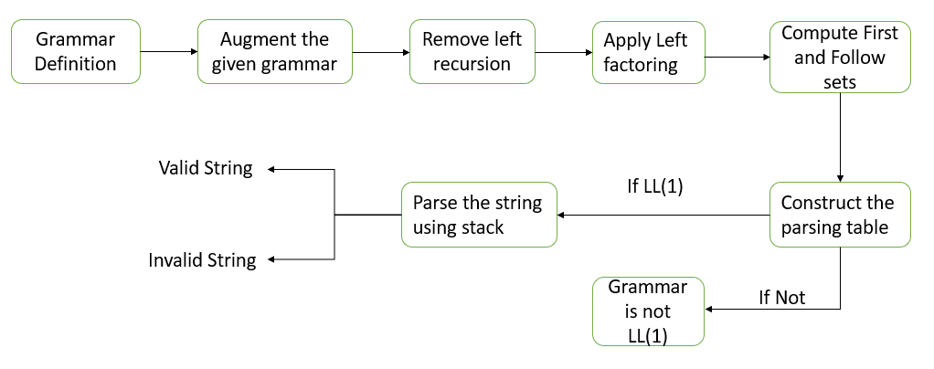
Methodology

Slide 6
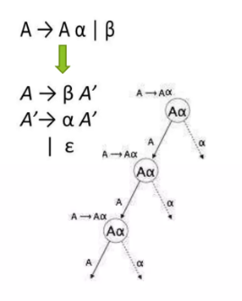
Implementation
Step1 : - Left Recursion Removal
Left recursion is a problem that occurs in grammars when the leftmost symbol of a production rule is the same as the non-terminal symbol on the left-hand side of the rule. This can cause infinite loops during parsing, so it is important to remove left recursion from grammars.
For each production of the form A → Aβ | , add a new production to the grammar that derives A' from α and β.

Slide 7
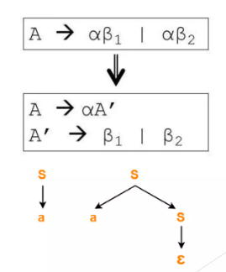
Implementation
Step1 : - Left Factoring Removal
Left factoring is a technique used to remove left recursion from a grammar. Left recursion occurs when a non-terminal symbol can be derived from itself by replacing it with itself. This can lead to ambiguity in the grammar, as it is not clear which production to use when the non-terminal symbol is encountered.

Slide 8
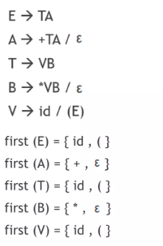
Implementation
Step3 : - First Calculation
FIRST is applied to the R.H.S. of a production rule :
• If first symbol is terminal then put into first(non-terminal).
• If non-terminal then go to that non-terminal production and continue above step.
• If # directly then put in first(non-terminal).
indirectly then put & check again.

Slide 9
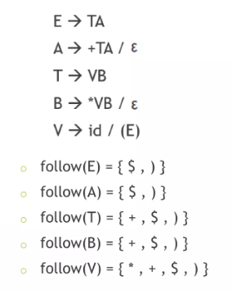
Implementation
Step4 : - Follow set Calculation
symbol put always $.
Find the non-terminal in R.H.S. whose follow has to be found in the grammar.
If its’s next element is terminal then put into follow(non-terminal)
if it is no terminal then copy follow(non-terminal) from which it is found.
E -> TE’ follow(E’)=follow(E)
If it is non-terminal then check the value of first(next) -> if it is terminal then put into follow(non-terminal). -> if then put back & check again.

Slide 10
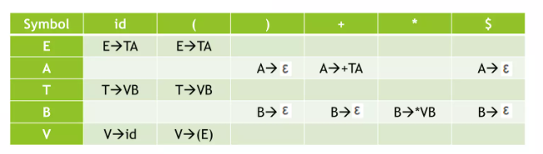
Implementation
Step4 : - Parsing Table Generation
Form a table whose
row1 contain all terminal from grammar set including $ and excluding .
column1 contains all non-terminals from grammar set.
For non-terminal n1 (n1->A) ,
if A is
terminal then put that production in row(terminal),column(n1).
non-terminal then check first(n1) & put production rule in that symbol.
then check follow(n1) & put into that symbol.
If in any cell ,we get two production then that grammar set will not be parsed by LL(1) grammar

Slide 11
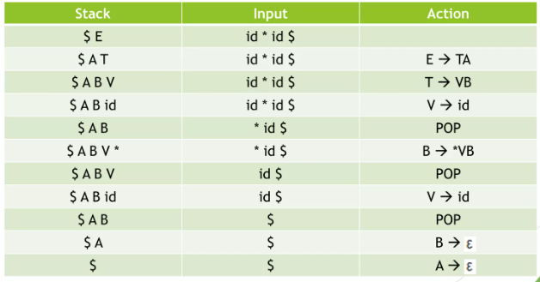
Implementation
Step6:- String Parsing
Parse given string from left to right.
Start from $ and starting symbol.
Replace symbol with it’s production, from which we can form the given input string.
Also write the action which we performed in stack.
Continue till we are left with $ in stack and input.

Slide 12
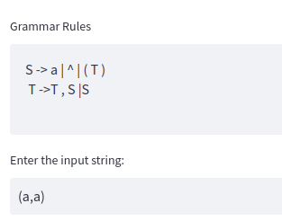
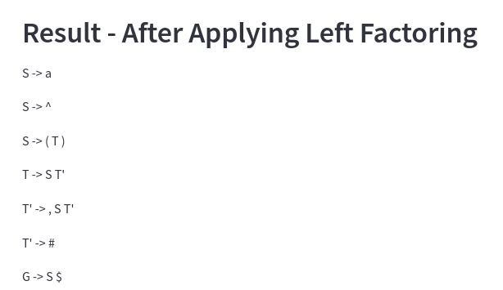
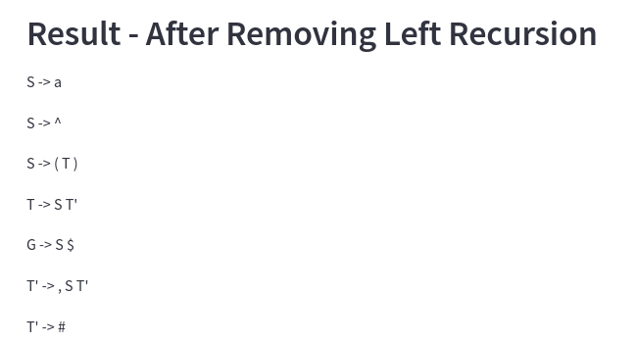
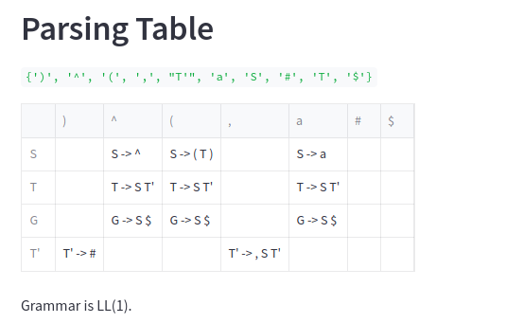
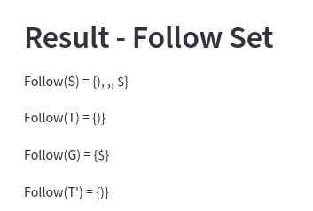
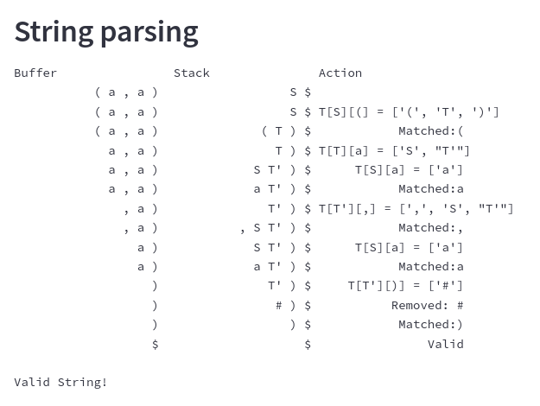
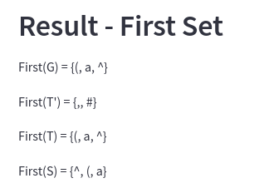
Results (Test case -1)

Slide 13
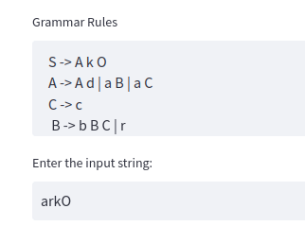
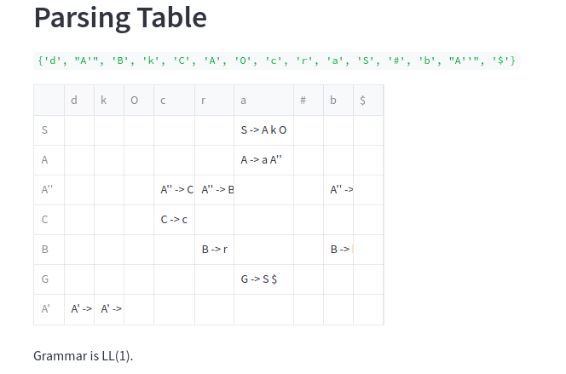
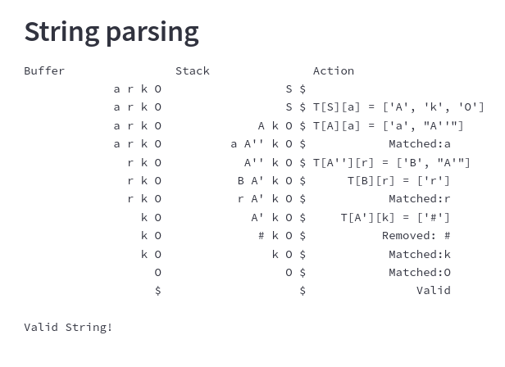
Results (Test case -2)

Slide 14
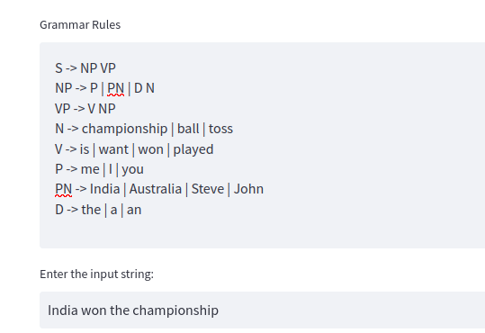
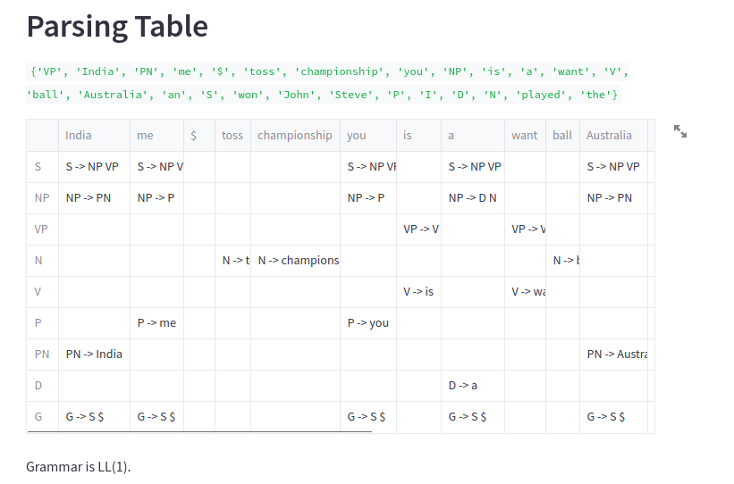
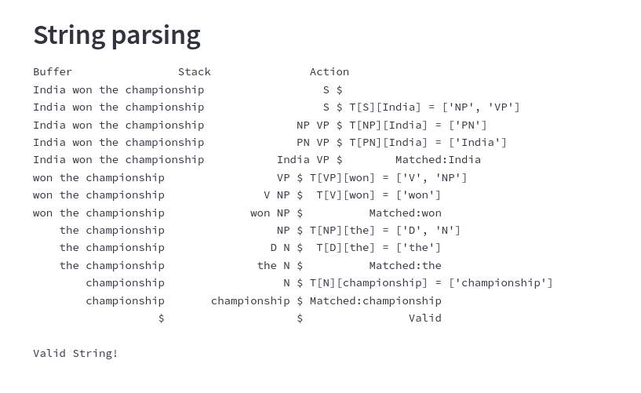
Results (Test case -3)

Slide 15
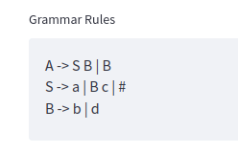
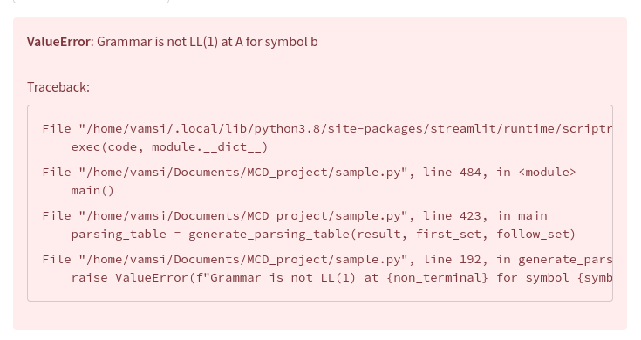
Results (Test case -4) Not LL1

Slide 16
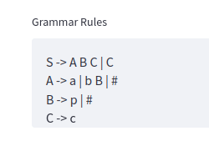
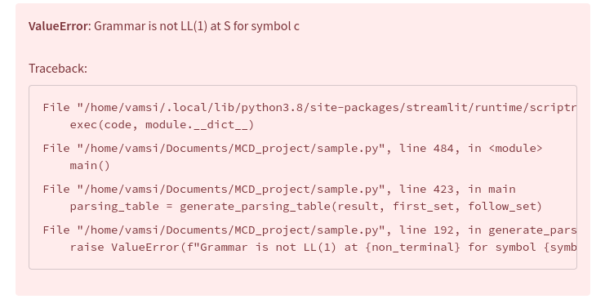
Results (Test case -5) Not LL1

Slide 17
Conclusion
In conclusion, implementing an LL(1) parser using Python allows for efficient and accurate parsing of programming language syntax.
The LL(1) parsing technique, based on predictive parsing, offers advantages such as simplicity, speed, and error detection. By following key steps such as grammar augmentation, left recursion removal, left factoring, and constructing the parsing table, we can successfully parse input strings.
The implementation showcased here demonstrates the process of validating and parsing strings using a stack and buffer approach.
The LL(1) parser implementation in Python provides a solid foundation for building robust compilers and language processors.

